Slide 1
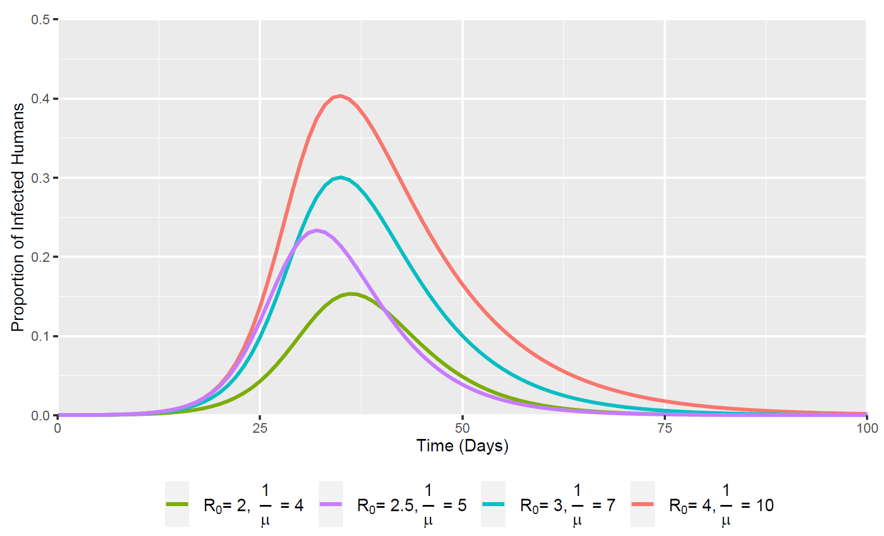
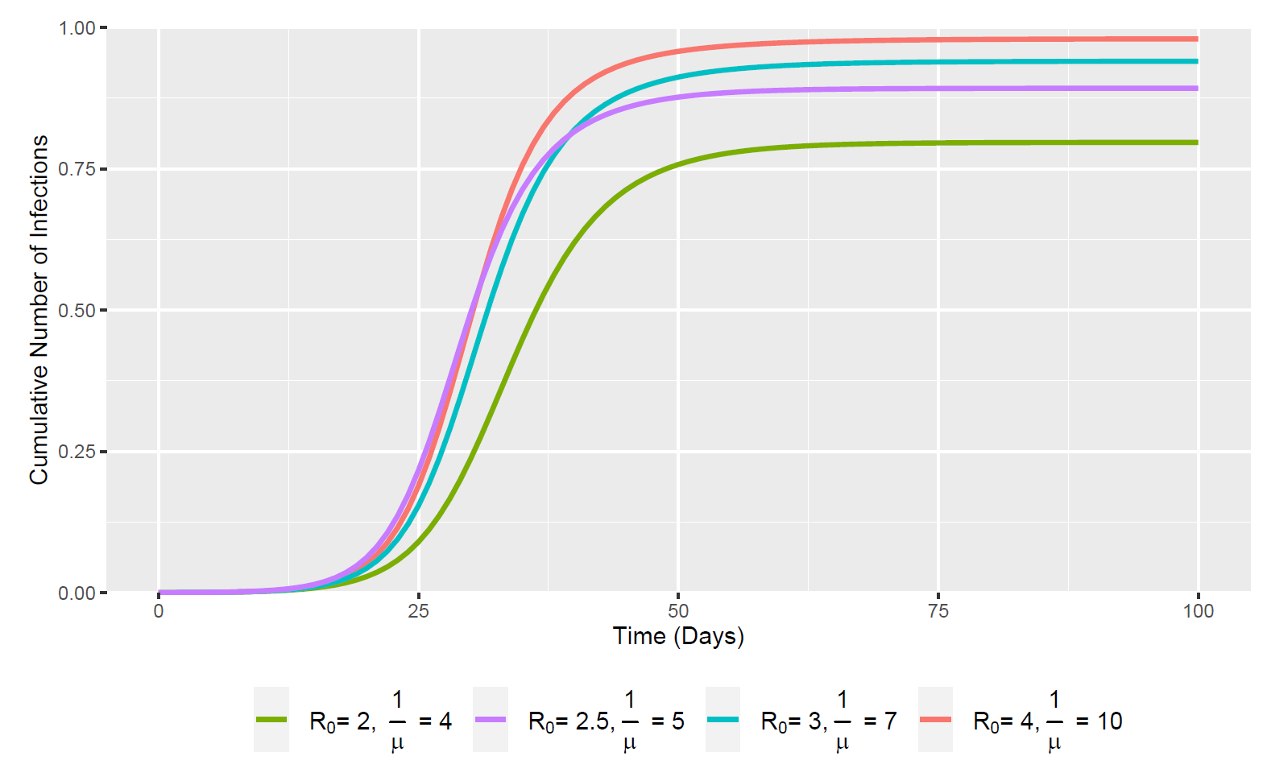
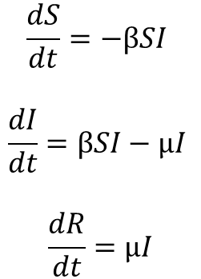
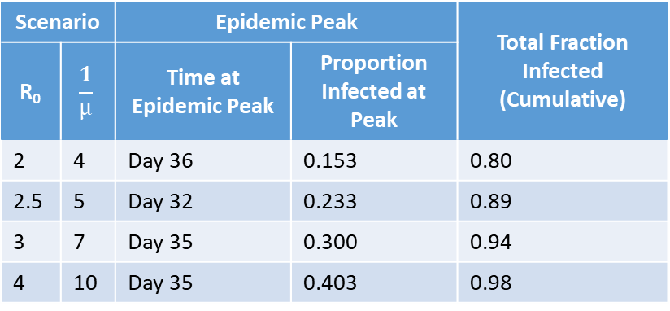
Standard SIR Model (No Demography)
$$\frac{dS}{dt}=−βSI$$
$$\frac{dI}{dt}=βSI−µI$$
$$\frac{dR}{dt}=µI$$
Initial Conditions: {S = 0.9999, I = 0.0001, R = 0}
Scenario |  | Epidemic Peak |  | Total Fraction Infected (Cumulative)
R₀ | $$\frac{1}{µ}$$ | Time at Epidemic Peak | Proportion Infected at Peak
2 | 4 | Day 36 | 0.153 | 0.80
2.5 | 5 | Day 32 | 0.233 | 0.89
3 | 7 | Day 35 | 0.300 | 0.94
4 | 10 | Day 35 | 0.403 | 0.98

Slide 2
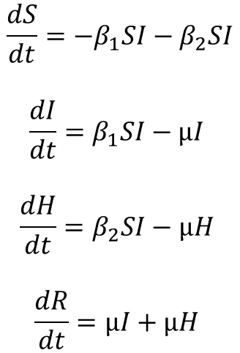
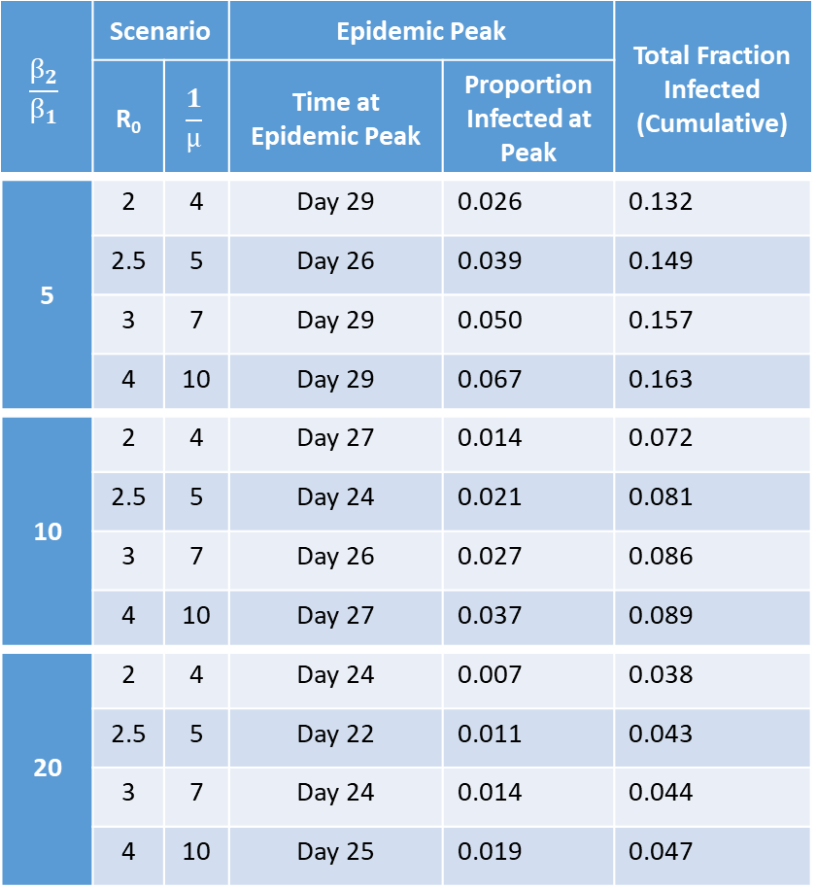
Standard SIR Model w/ “Hidden” Infected
Compartment (No Demography)
$$\frac{β_{2}}{β_{1}}$$ | Scenario |  | Epidemic Peak |  | Total Fraction Infected (Cumulative)
 | R₀ | $$\frac{1}{µ}$$ | Time at Epidemic Peak | Proportion Infected at Peak
5 | 2 | 4 | Day 29 | 0.026 | 0.132
 | 2.5 | 5 | Day 26 | 0.039 | 0.149
 | 3 | 7 | Day 29 | 0.050 | 0.157
 | 4 | 10 | Day 29 | 0.067 | 0.163
10 | 2 | 4 | Day 27 | 0.014 | 0.072
 | 2.5 | 5 | Day 24 | 0.021 | 0.081
 | 3 | 7 | Day 26 | 0.027 | 0.086
 | 4 | 10 | Day 27 | 0.037 | 0.089
20 | 2 | 4 | Day 24 | 0.007 | 0.038
 | 2.5 | 5 | Day 22 | 0.011 | 0.043
 | 3 | 7 | Day 24 | 0.014 | 0.044
 | 4 | 10 | Day 25 | 0.019 | 0.047
$$\frac{dS}{dt}=−β_{1}SI−β_{2}SI$$
$$\frac{dI}{dt}=β_{1}SI−µI$$
$$\frac{dH}{dt}=β_{2}SI−µH$$
$$\frac{dR}{dt}=µI+µH$$
Initial Conditions: {S = 0.9999, I = 0.0001, H = 0, R = 0}

Slide 3
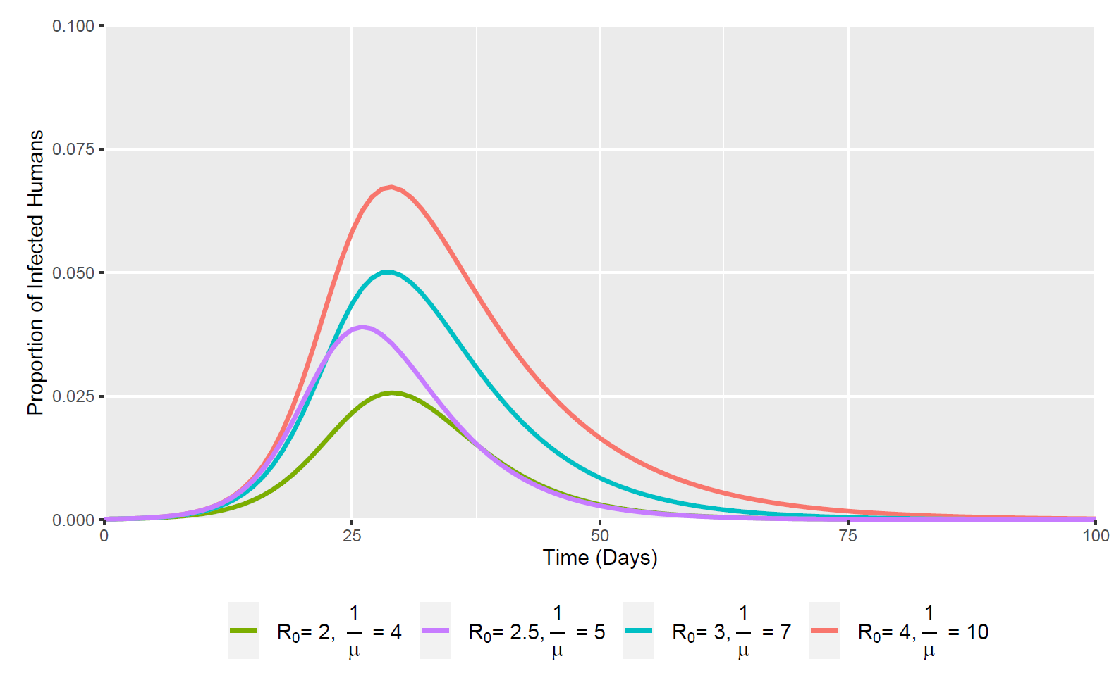
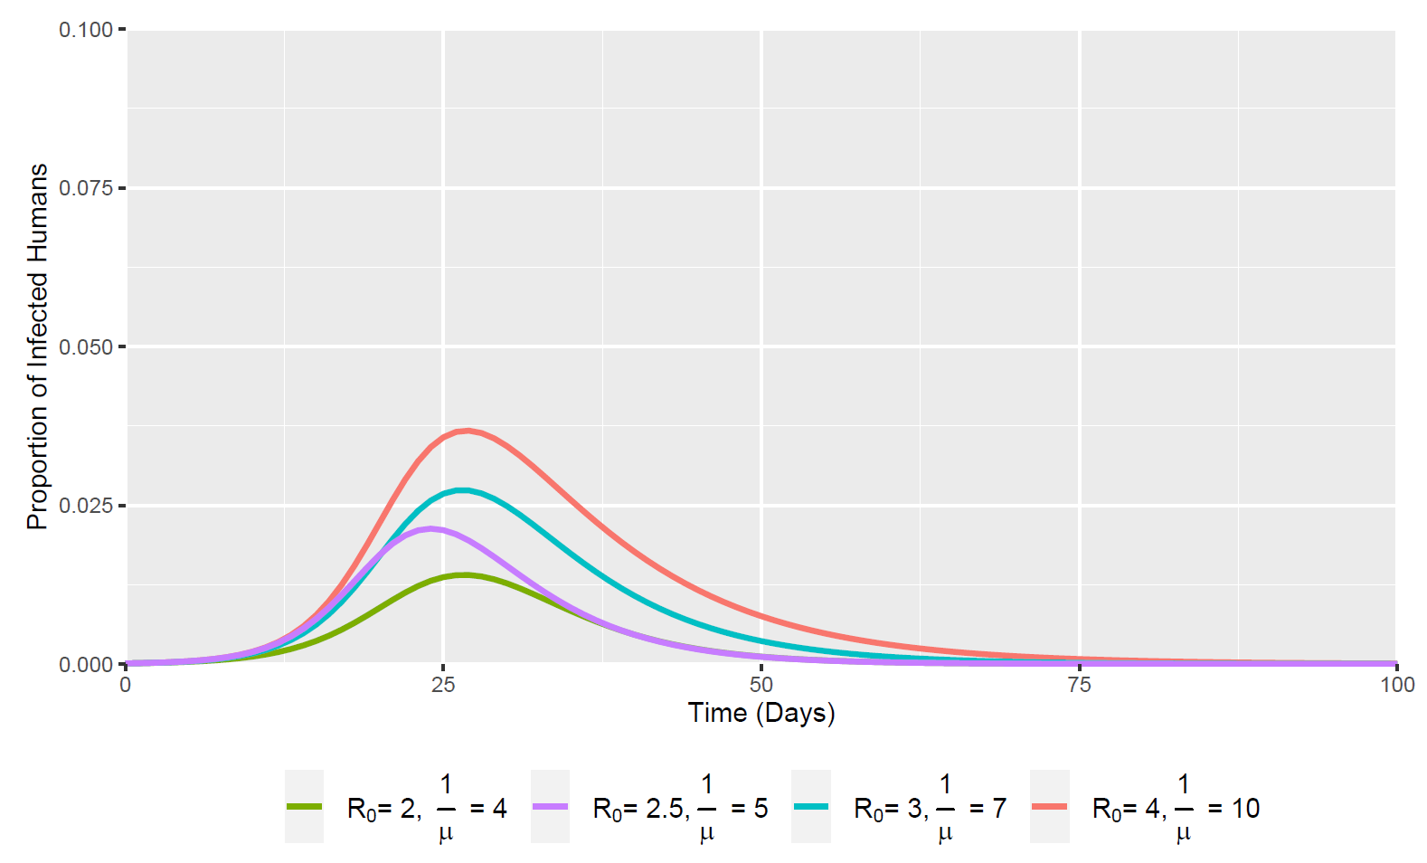
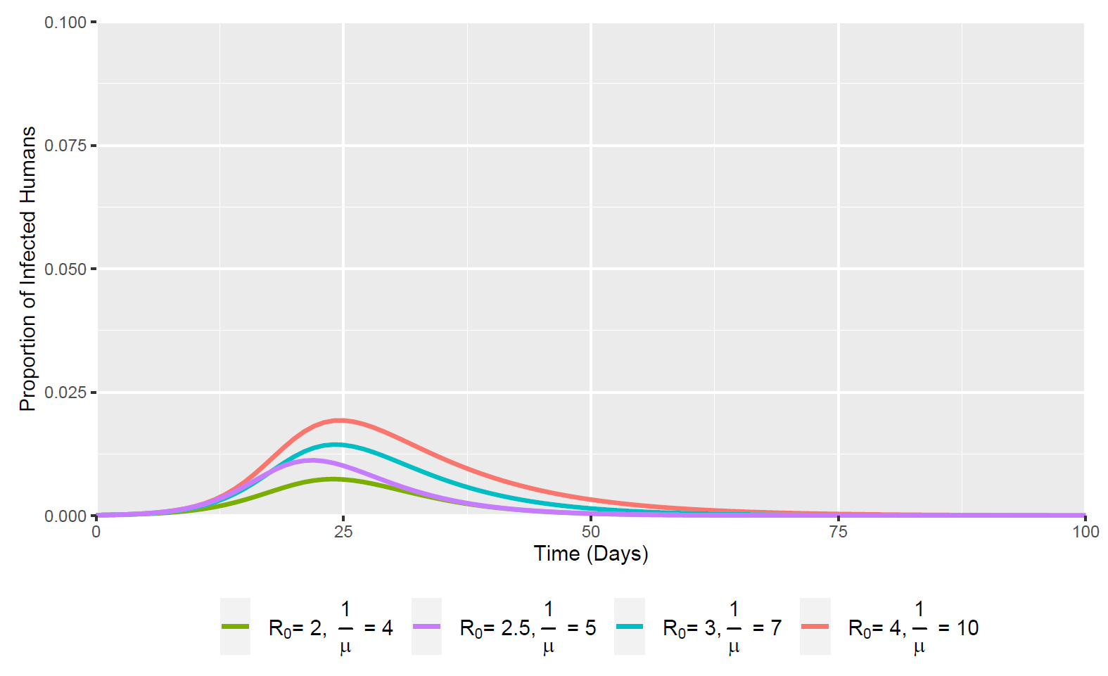
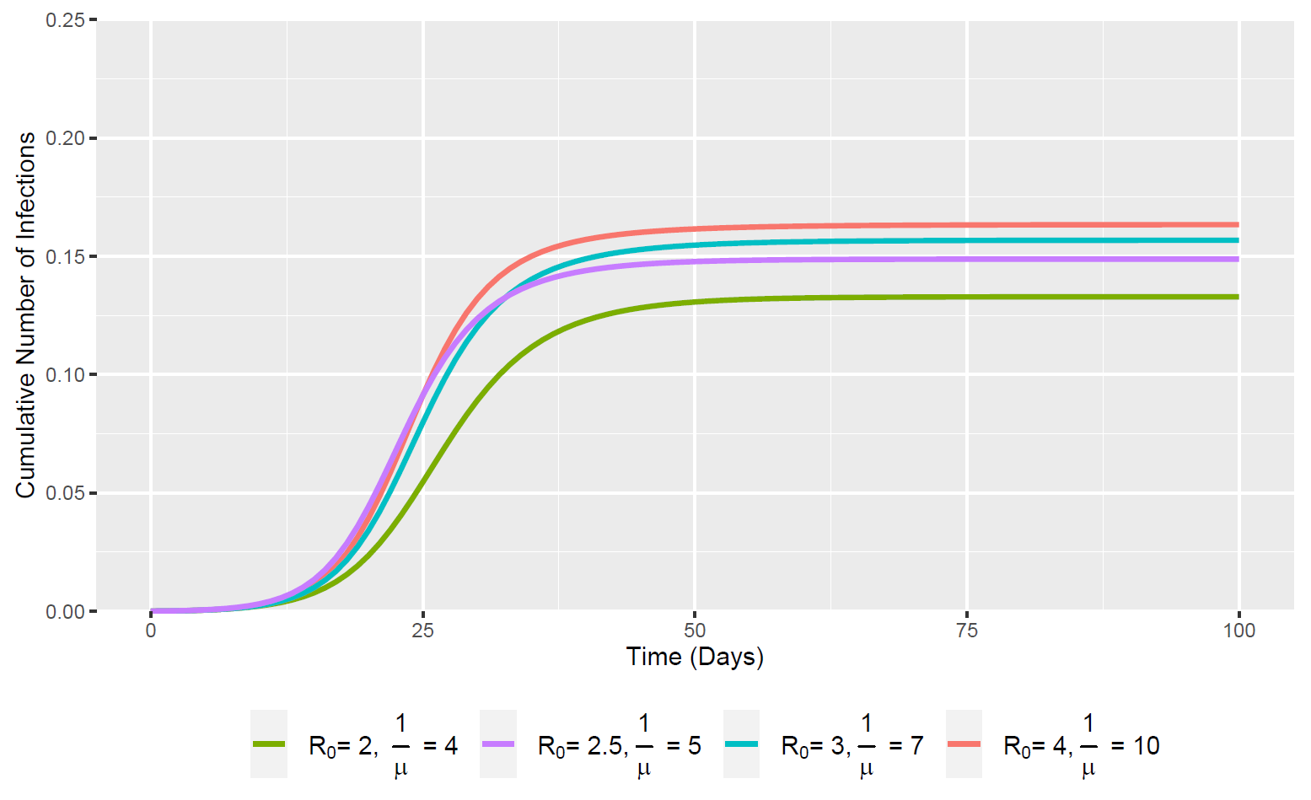
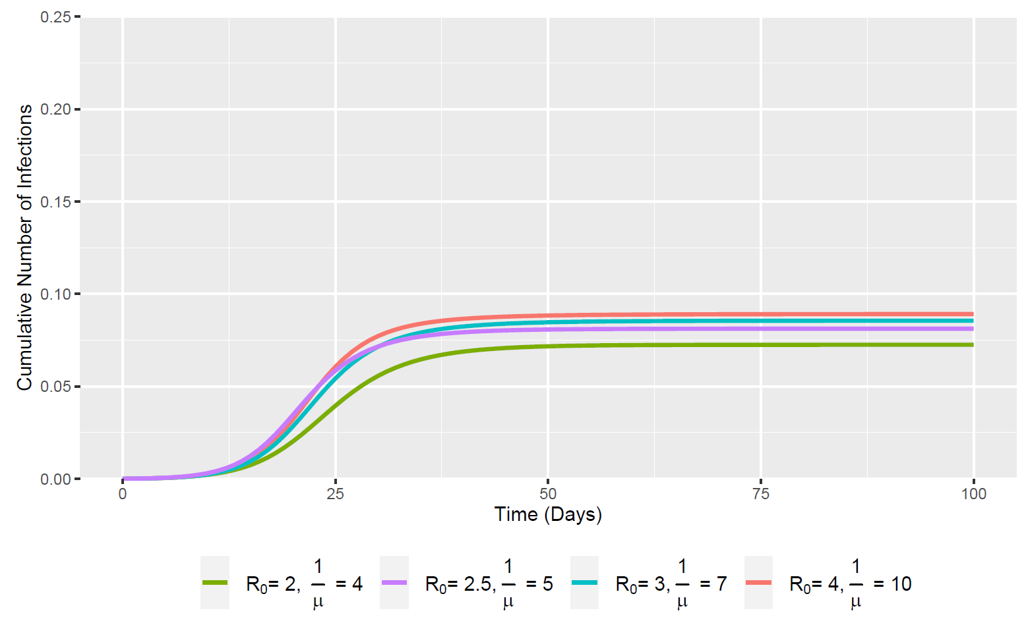
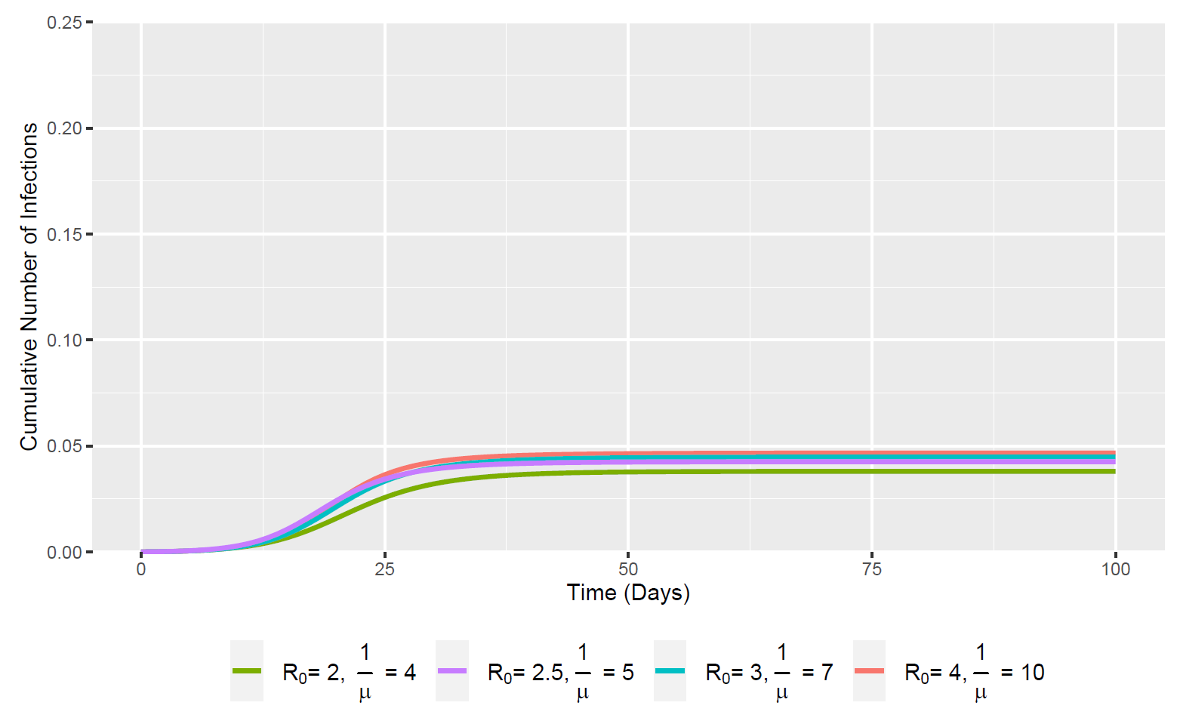



Normal Infected Individuals – “I” Compartment
$\frac{β_{2}}{β_{1}}$ = 5
$\frac{β_{2}}{β_{1}}$ = 10
$\frac{β_{2}}{β_{1}}$ = 20
(Note the rescaled y-axis compared to the first 2 plots – {0 – 0.1; 0 – 0.25})

Slide 4
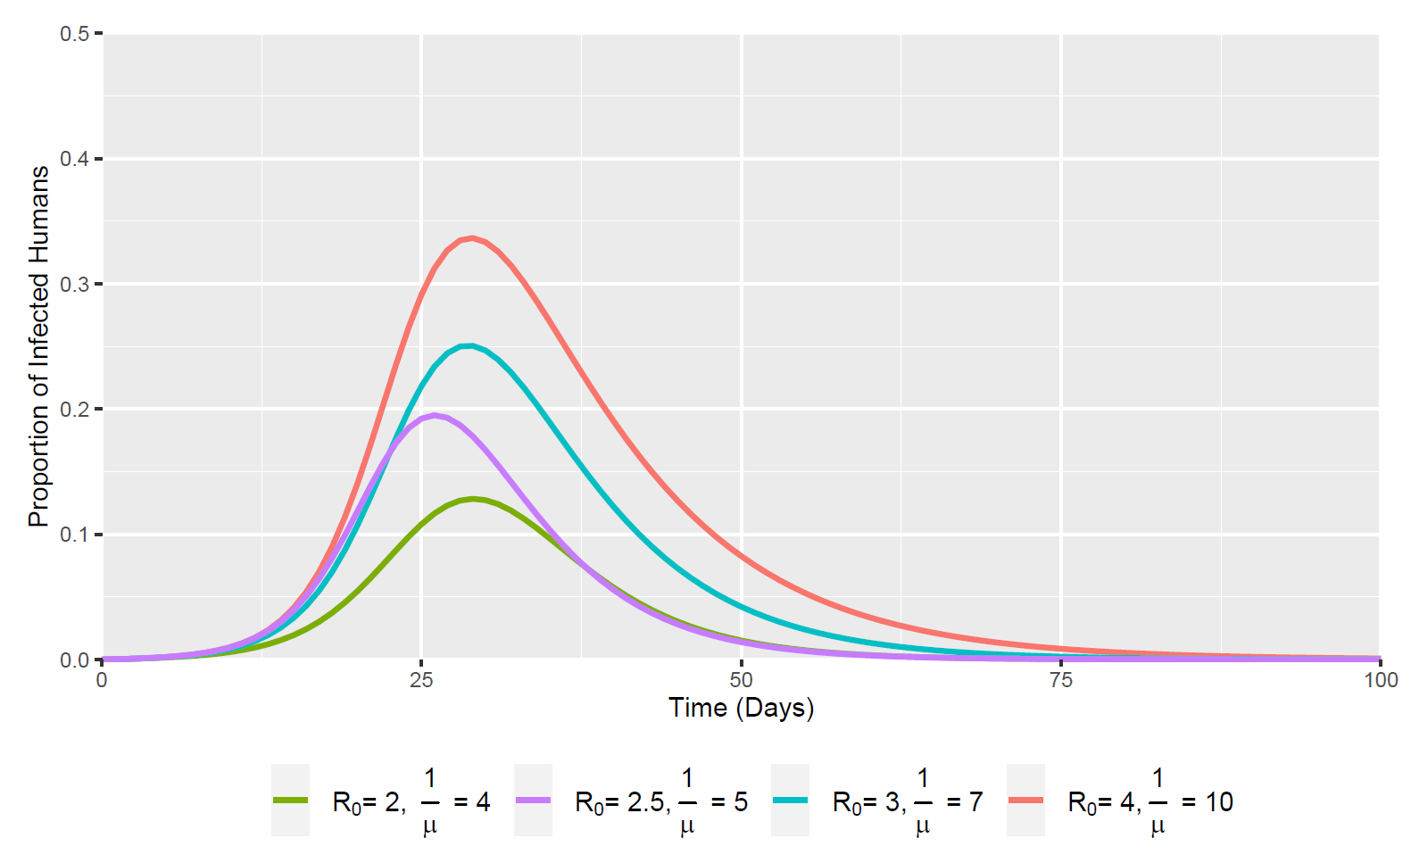
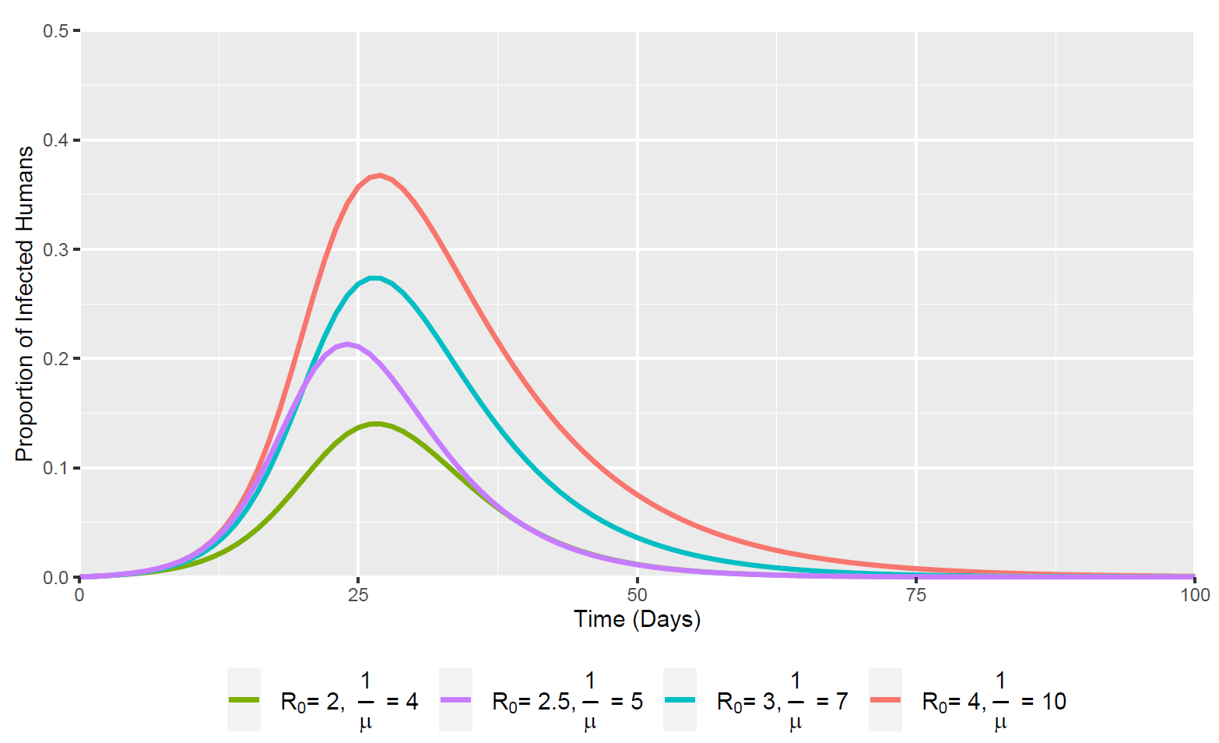
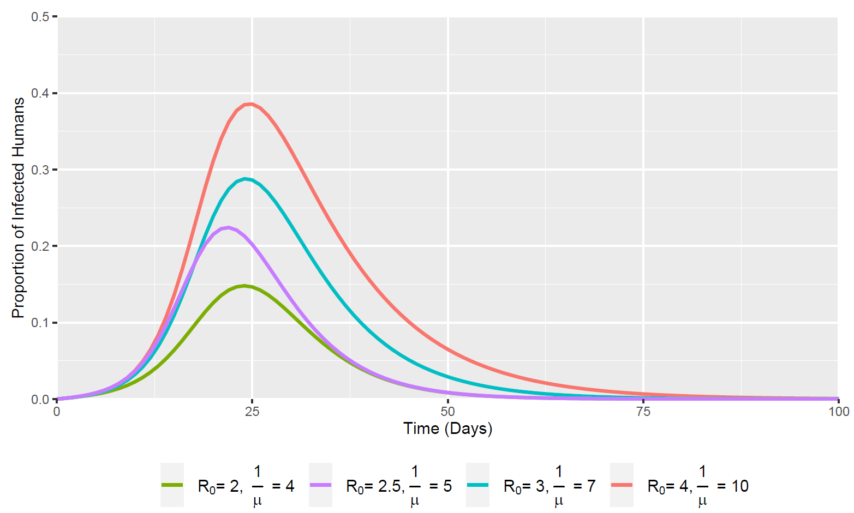
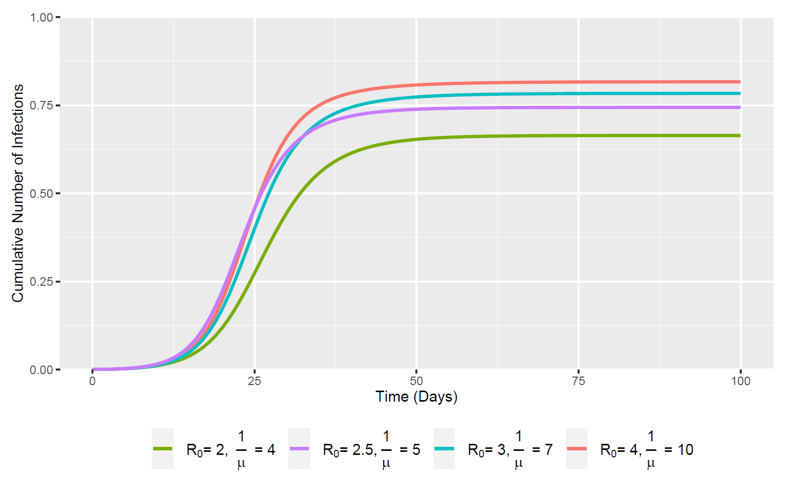
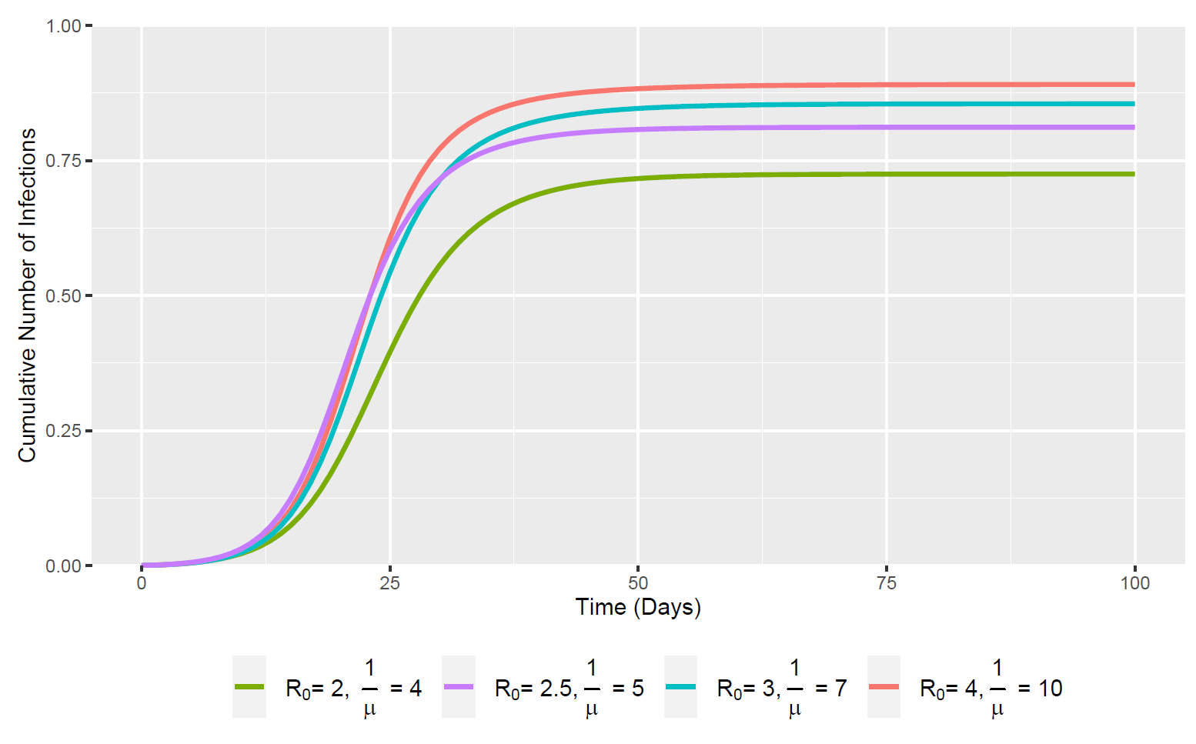
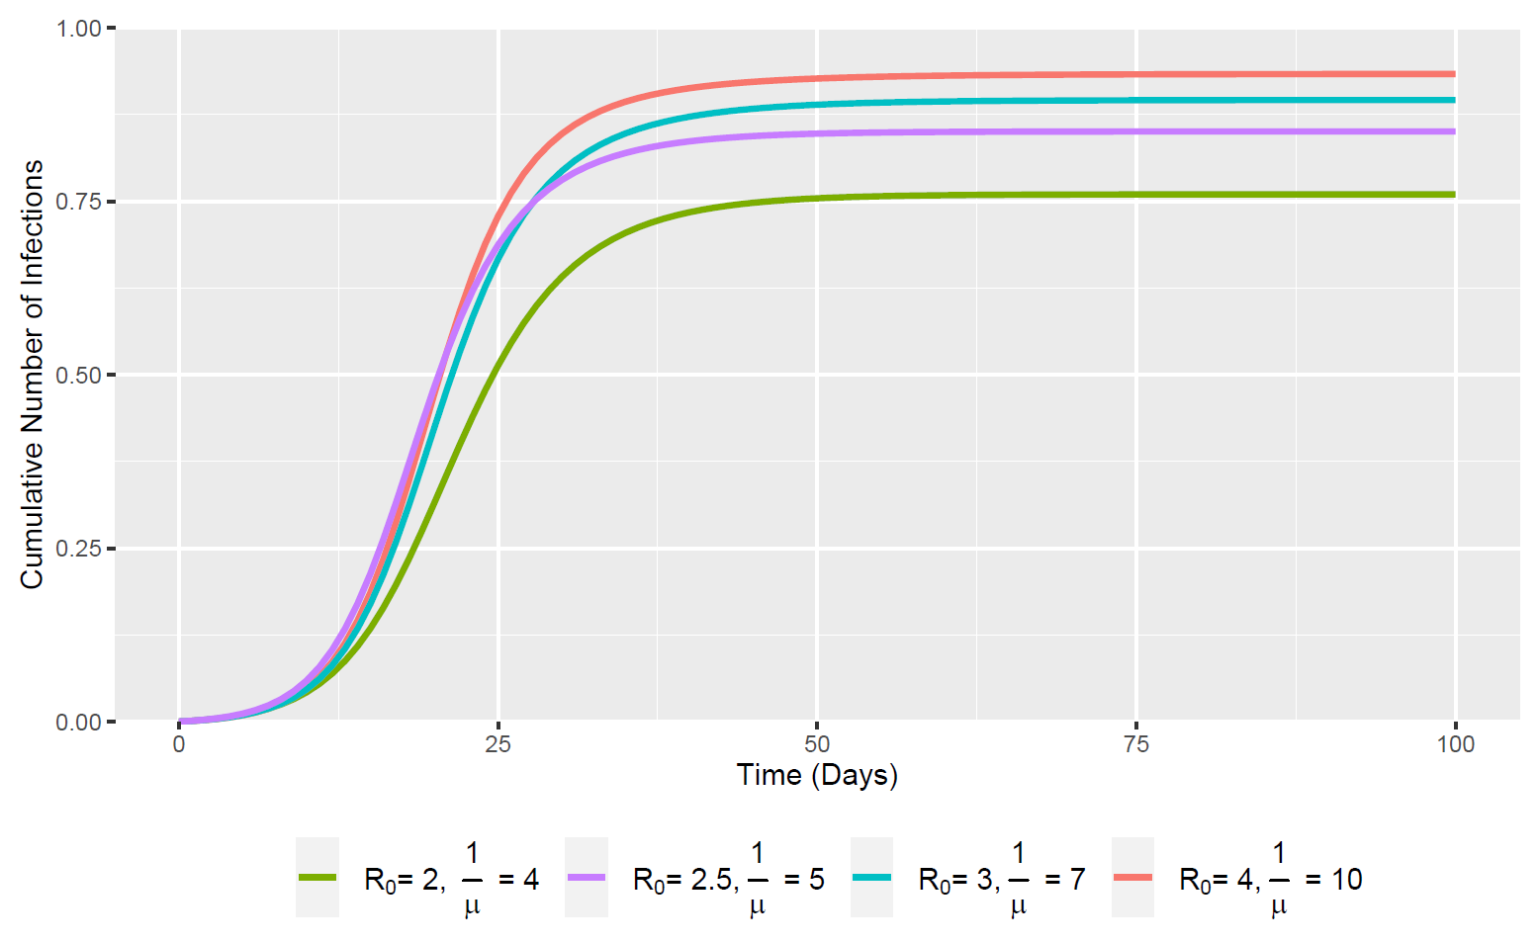
“Hidden” Infected Individuals – “H” Compartment
$\frac{β_{2}}{β_{1}}$ = 5
$\frac{β_{2}}{β_{1}}$ = 10
$\frac{β_{2}}{β_{1}}$ = 20
(Note the rescaled y-axis compared to the first 2 plots – {0 – 0.5; 0 – 1})

Slide 5
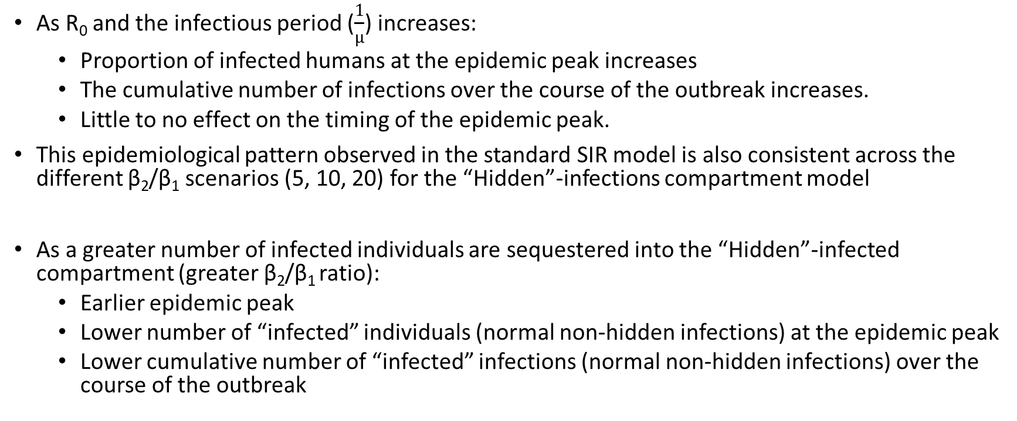
Summary
As R₀ and the infectious period ($\frac{1}{µ}$) increases:
Proportion of infected humans at the epidemic peak increases
The cumulative number of infections over the course of the outbreak increases.
Little to no effect on the timing of the epidemic peak.
This epidemiological pattern observed in the standard SIR model is also consistent across the different β₂/β₁ scenarios (5, 10, 20) for the “Hidden”-infections compartment model
As a greater number of infected individuals are sequestered into the “Hidden”-infected compartment (greater β₂/β₁ ratio):
Earlier epidemic peak
Lower number of “infected” individuals (normal non-hidden infections) at the epidemic peak
Lower cumulative number of “infected” infections (normal non-hidden infections) over the course of the outbreak

Slide 6
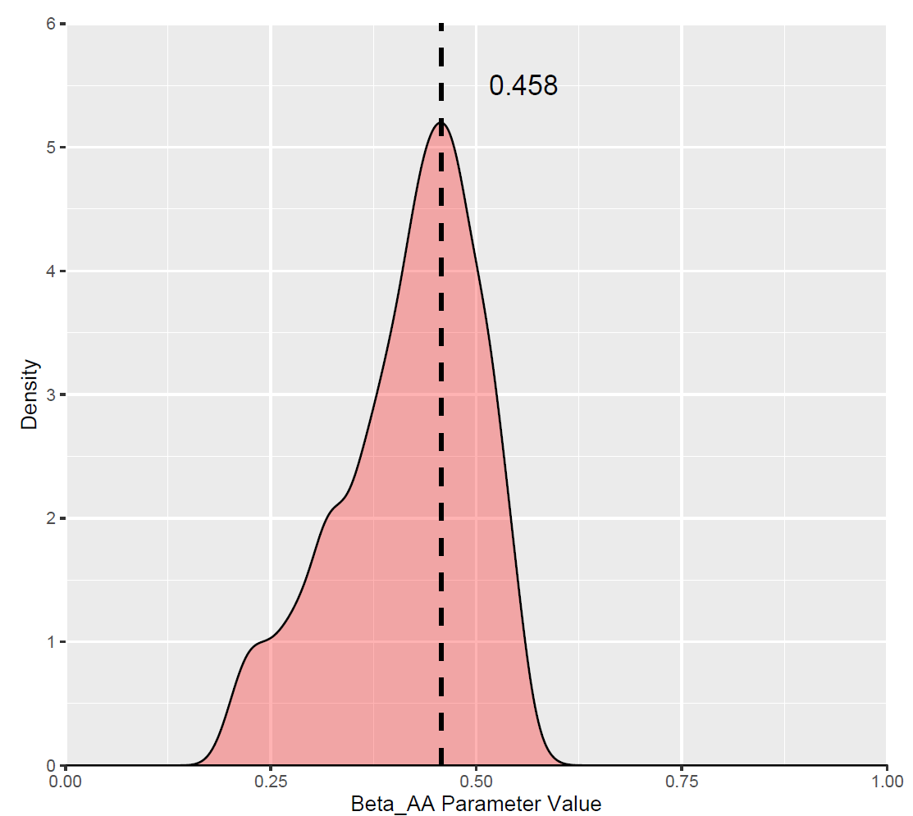
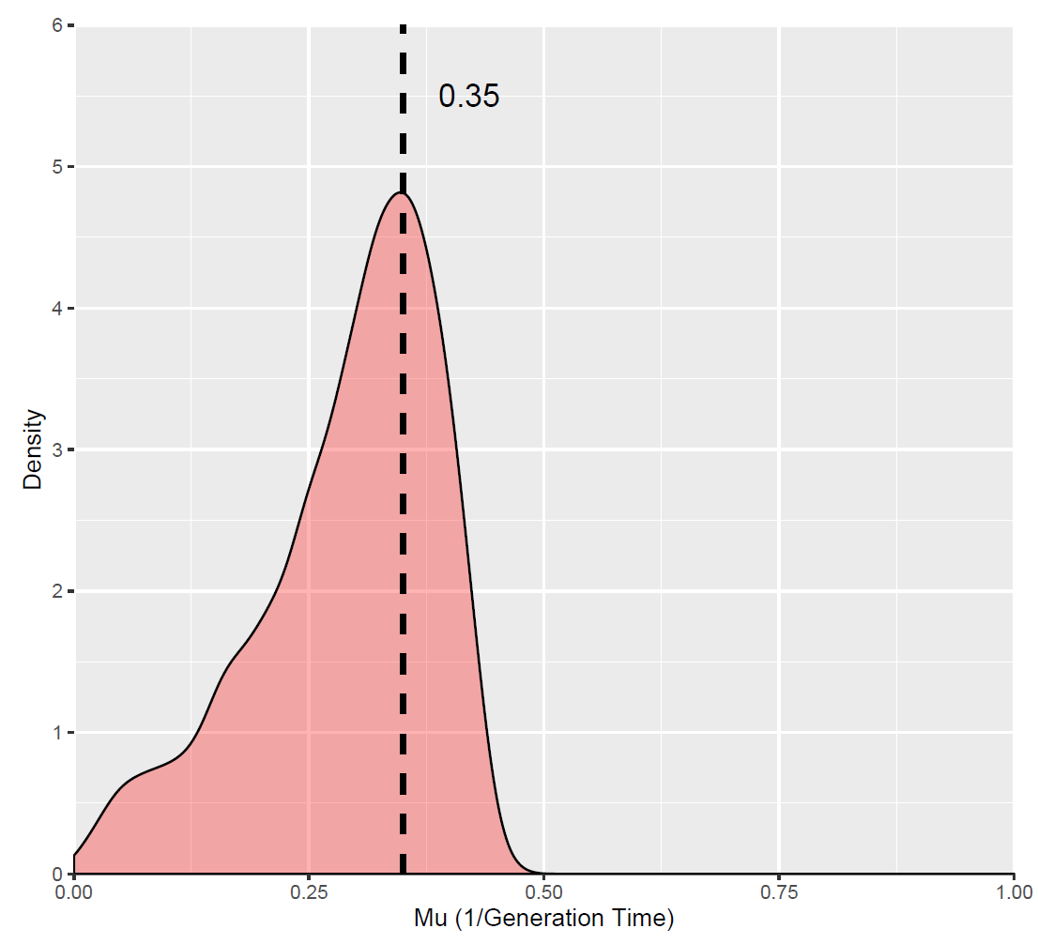
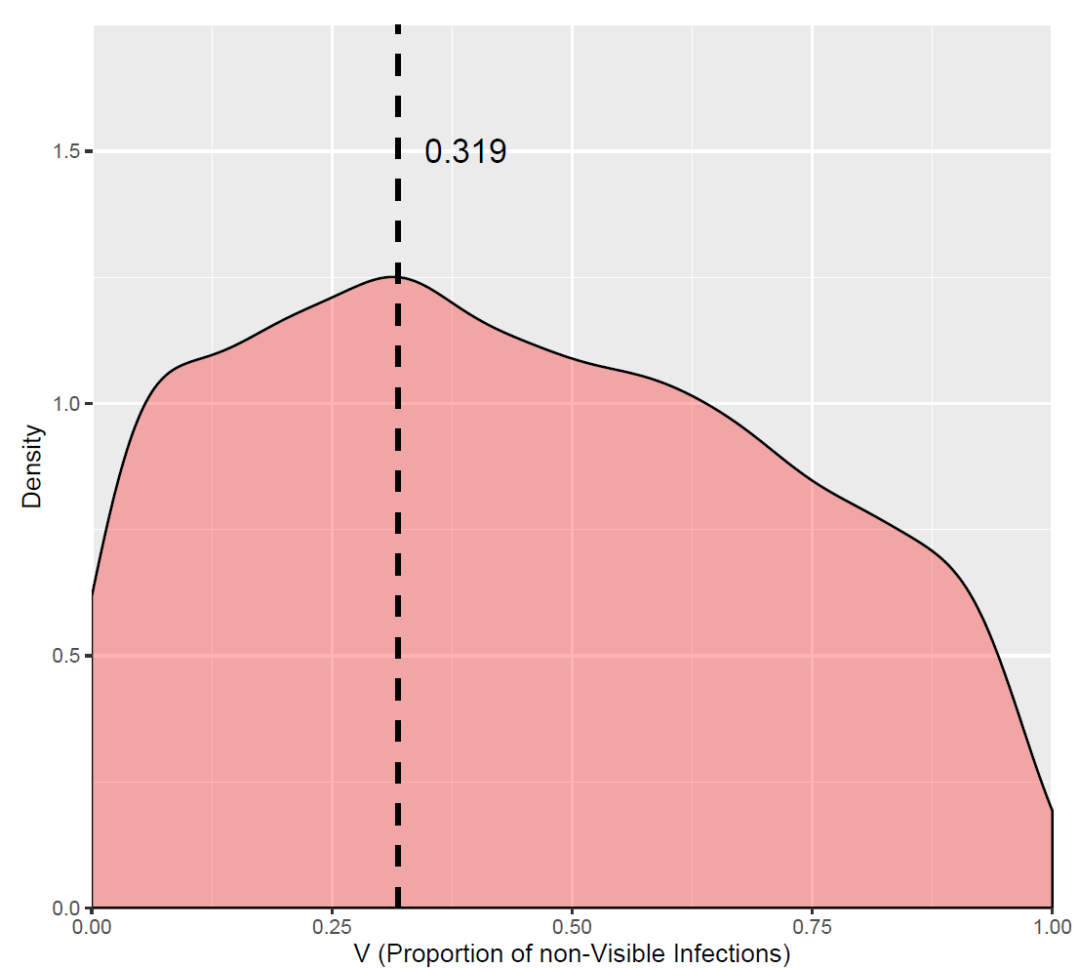
Posterior For SIHR/SIVR Model Fit

